Slide 1


SMART HOME PROJECT

Slide 2
Team :
Abdulrahman Rashad Eid Tahoun
Shehab Alaa Ahmed Abdelhadi
Ahmed Ashraf Ibrahem Mohammed
Mohamed Gamal Mohamed
Mahmoud Ahmed Mahmoud Abdulrahman
Eslam Mohamed Abdelfatah Taha
Under Supervision :
Dr / Mohamed Eng / Fahd Badi Eng / Omar Mahfouz

Slide 3
Smart systems incorporate functions of sensing, actuation, and control in order to describe and analyze a situation, and make decisions based on the available data in a predictive or adaptive manner, thereby performing smart actions.
The Advantages :
Managing all of your home devices from one place.
Flexibility for new devices and appliances.
Maximizing home security.
Remote control of home functions.
Increased energy efficiency.
Improved appliance functionality.
Home management insights.

Slide 4
MICROCONTROLLER
AVR - ATMEGA32
TOOLS
ECLIPSE PROGRAM
PROTEUS 8.11 FOR SIMULATION
SERIAL BLUETOOTH TERMINAL APP

Slide 5
PERIPHERALS
MCAL
UART
DIO
EEPROM
ADC
Timer
Timer0
Timer1

Slide 6
TOOLS H-W
HAL
BLUETOOTH
TEMPERATURE
SENSOR
LM35
AC(DC MOTOR)
5 ROOMS(5 LEDS)
BUZZER
DOOR (SERVO MOTOR)
DIMMER CIRCUIT (LED+POTENTIOMETER)
KEYPAD
LCD

Slide 7
SYSTEM MODES
ADMIN
REMOTE USER
KEYPAD USER
FULL CONTROL ON THE SYSTEM(USING MOBLIE APP)
CONTROL FOR THE SYSTEM EXCEPT THE DOOR (USING MOBILE APP)
CONTROL FOR THE SYSTEM EXCEPT THE DOOR (USING KEYPAD)

Slide 8
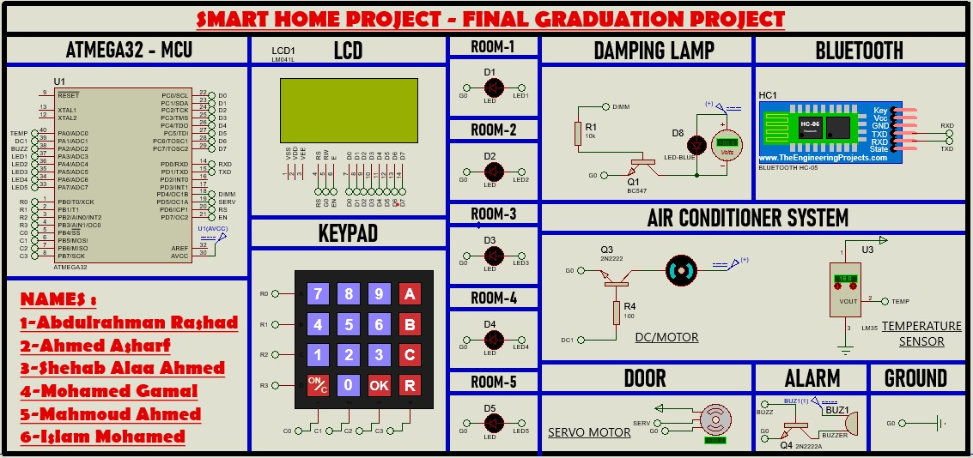
PROTEUS

